Slide 1
Building custom engine agents with Azure AI Foundry and Visual Studio Code

Slide 2
Agenda
Custom Engine Agents Overview
Introduction to Teams Toolkit
Getting started with Microsoft 365 Agents SDK
Advancing agents with Teams AI library
Summary & Resources
Notes:
Ayca

Slide 3






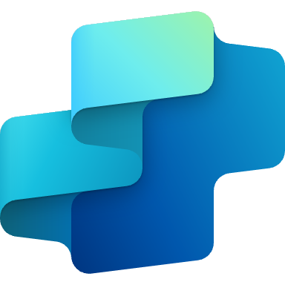

Build agents on your terms
Declarative agents
Custom engine agents
Built and run on Microsoft 365 Copilot
Built and run on your custom AI engine
Declare instructions, actions, and knowledge sources
Full control over orchestration, models and more
Deploy across
Deploy across
No code
Pro code
Notes:
Ayca

Slide 4


Agent architecture
Custom Engine Agents
User experience
Microsoft Teams
Microsoft 365 Copilot
Messenger
White label Web chat
Email
+10 other front-end channel
Knowledge
Instructions and Grounding
Agents
Orchestrator
Skills
Actions, triggers, workflows
Autonomy
Planning, exceptions, self-learning
Microsoft provided
Foundation models
Developer provided
Notes:
Carter
Here is general structure of a custom engine agent that you can fully customize as a developer
The Agent architecture consists of one or more foundational models, an orchestrator, knowledge, skills, autonomous capabilities and a user experience / UI
Foundational models are AI models that can perform a wide range of tasks, from language processing, visual comprehension, text generation, code writing and more.
Orchestrator oversees and synchronizes pre and post processing of the user prompt across foundation models, knowledge and actions.
Knowledge is the information agents can reason over to answer user prompts. Agents can expand their native semantic understanding beyond the source data used for their training to provide relevant, contextual responses.
Skills such as Actions are tasks agents can perform on your behalf, from real-time data lookups to executing changes and updates on behalf of the user.
Custom engine agents can be deployed across Microsoft Teams, M365 Copilot (coming soon), web, outlook and + other messaging channels.
The glue that holds everything together so you can accelerate your build are two SDKs: Microsoft 365 Agents SDK and the Teams AI Library

Slide 5

Build for Breadth to Collaborative Depth
Build Once, Publish everywhere
In-Depth Collaborative Agents
Microsoft 365 Agents SDK
Teams AI Library
Public Preview
Generally Available
Notes:
When the initial generative AI wave started a couple of years ago, we introduced the Teams AI Library—a powerful toolkit built upon Microsoft's bot framework designed specifically for modernizing Teams bots.
The feedback was overwhelmingly positive, with many asking for expanded support beyond Teams to multiple communication channels.
In response, we introduced a preview of the Microsoft 365 Agents SDK at Ignite, a modernized foundation enabling developers to build agents once and distribute them across multiple platforms seamlessly.
Meanwhile, the Teams AI Library (which is GA) continues to evolve independently with focus on delivering rich collaborative features, simplifying the creation of sophisticated agents tailored specifically for collaborative workflows within Teams.
These two SDKs complement each other: use the Microsoft 365 Agents SDK for multi-channel deployment, and when you're ready to deepen collaborative features in Teams, leverage the specialized capabilities of the Teams AI Library.
“Agent SDK plans to announce GA for C#, JS, Python for //Build”

Slide 6
Breadth to Collaborative Depth
Web
Teams
Outlook
Microsoft 365
Copilot
…more
Microsoft 365 Agents SDK: Breadth
Multi-hub, multi-channel
Build once, works everywhere
Conversation manager
Conversation manager
Conversation manager
Conversation manager
Conversation manager
Web components
Meetings
Outlook add-in hooks
Sydney orchestrator
TBD
Teams AI Library: Depth
Single hub: Teams
Uses Teams-centric context and canvas
CSS styling
Chat/Channel Scopes
Email contexts
M365 grounding
Collab stages
Code interpreter
Message Extensions + Dialogs
Notes:
In practice, when using the Microsoft 365 Agents SDK, developers can easily deliver a consistent agent experience across multiple channels.
<CLICK>
At its core, the SDK enables agents to handle natural-language conversations, extract insights from data, and deliver powerful scenarios seamlessly across various platforms.
The SDK manages channel-specific differences behind the scenes, simplifying deployment and management of a centralized agent—similar to the approach of Copilot Studio.
However, each channel has unique capabilities; for instance, Teams offers specialized collaborative features like meetings and collaborative stages that aren't available in Outlook or on the web.
<CLICK>
To deeply leverage these specialized Teams collaboration features, you can utilize the Teams AI Library, specifically designed to enhance teamwork within Teams collaborative spaces. When you’re ready you can import the AI Library into you agent and layer on the teams functionality that will light up when your users utilize teams without needing to maintain a separate agent
You can do this today and the team is working on streamlining this process by mid-year

Slide 7
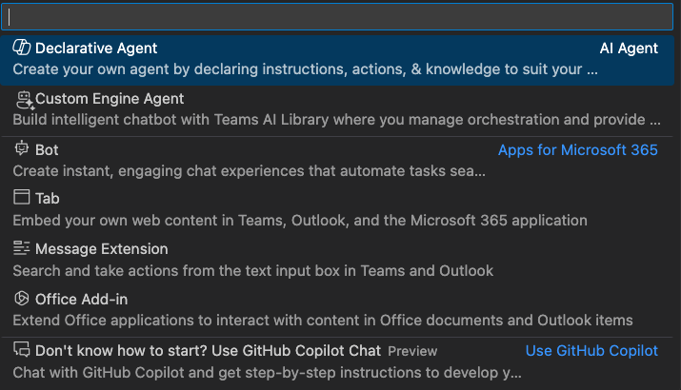

Teams Toolkit for Visual Studio Code
Developer tools for building custom copilots and apps for Teams, Outlook, and the M365 app.
aka.ms/teams-toolkit

Slide 8
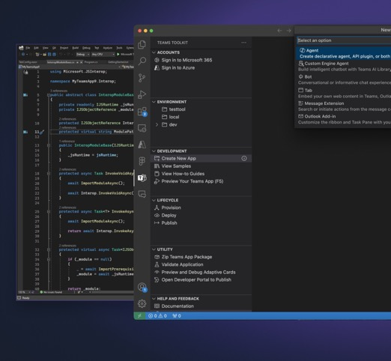
Get started easily with Teams Toolkit
Simple way to get started with project templates
Save time with automatic app registration
Smart defaults for hosting in Azure
Use .NET, JS/TS or Python!
Notes:
Carter

Slide 9
Microsoft 365 Agents SDK
Introducing
Public Preview
Your agent, your way for the most advanced needs
Build on your terms with Azure AI or your choice
Seamlessly integrate into and from
Copilot Studio
Publish across multiple channels
Notes:
Ayca

Slide 10
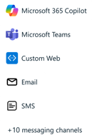

Inside an agent built with the Microsoft 365 Agents SDK
Your own custom engine agent
M365 Agents SDK
+
Customer Code
M365 Agents SDK
+
Customer Code
Any orchestration framework
Azure AI Foundry
Orchestration
Other AI Services
Semantic Kernel
Langchain
…
Copilot Studio
Copilot Studio
AI services
User asks a question and sends it to the client
User sees a response in the client
Orchestration
Dataverse & Plugins/Actions

Slide 11
Microsoft 365 Agents SDK
Your agent, your way
AI services of your choice
Channels of your choice
Low and pro-code

Slide 12
Demo
Microsoft 365 Agents SDK

Slide 13


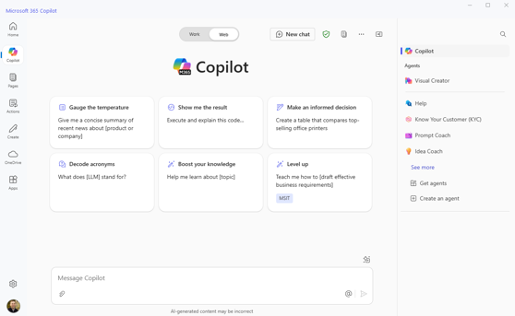
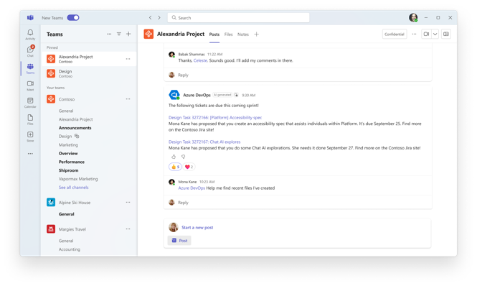
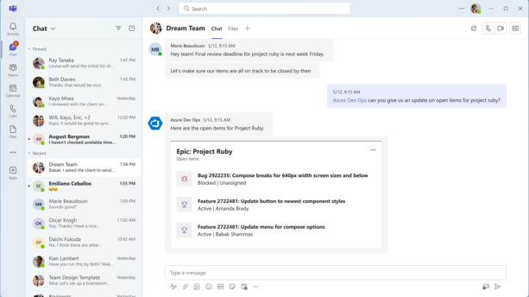
Agents as Teammates
Personal
Collaborative
Notes:
Carter
When thinking about AI agents as teammates, it's helpful to distinguish between personal productivity and team collaboration use cases
Let's explore two complementary agent experiences: Copilot for Microsoft 365 (focused on individual productivity) and Microsoft Teams (geared towards collaboration).
Agents within Microsoft Copilot help with individual workflows—like preparing for the week ahead, crafting emails, or quickly accessing organizational data. These agents interact with you personally in 1:1 chat
As agents evolve, and become more autonomous and capable of managing more complex tasks, we can go beyond 1:1 interactions. We can extend agent experiences to enhance team collaboration, improving productivity across groups, breaking down organizational silos, and driving collective outcomes.
Today, the we’re excited to discuss this broader vision—how agents can elevate your entire team's effectiveness and collaboration on Microsoft Teams

Slide 14





Agents
HR agent
IT agent
PM agent
Legal agent
Tutor agent
Personal Agents
Collaborative Agents
Notes:
Agents can be specialized subject-matter experts (SMEs) tailored to specific roles (HR, IT, PM …) – <CLICK>
These specialized agents help employees efficiently complete tasks by leveraging role-specific knowledge and skills.
While personal productivity is valuable, collaborative workflows are crucial <CLICK>
In most cases, specialized agents should support group collaboration to enable teams to tackle complex projects that individuals can't achieve alone.
Focusing on team-level agent interactions is essential to fully unlock and elevate enterprise-wide productivity.

Slide 15
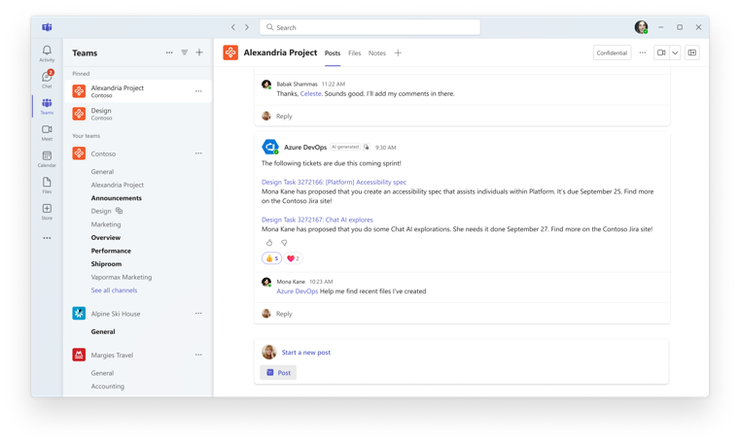





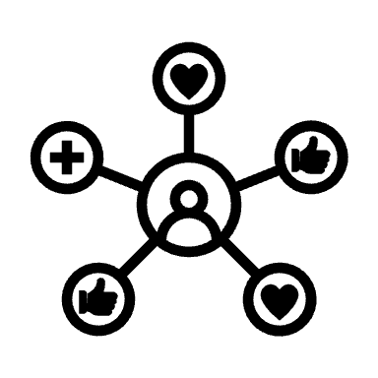
Collaborative agents
Collaboration-focused AI assisting teams
Understands group context & team goals
Executes long-running tasks notifying teams when actions are necessary
Proactivity & coordination with agents and team members enhancing group productivity
Notes:
For an agent to be a teammate, they need to be where teams collaborate (like Microsoft Teams), and in the flow of their work across chats, channels, and meetings.
Agents on Teams can collaborate with employees and even other agents participating in group workflows like any other teammate by @mentioning them, and agents can understand the context of the conversation and goals of your team.
When necessary, agents can pull in human teammates for approvals or additional input, ensuring smooth and efficient workflows (HITL)
Proactive capabilities empower agents to anticipate team needs, such as reminding about upcoming deadlines or sprint tasks, to ensure the team stays aligned and productive.

Slide 16

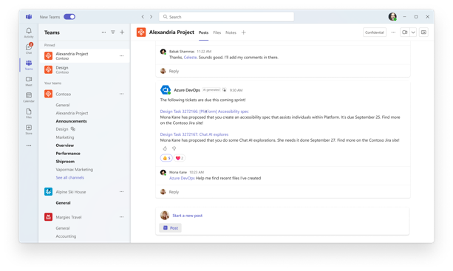
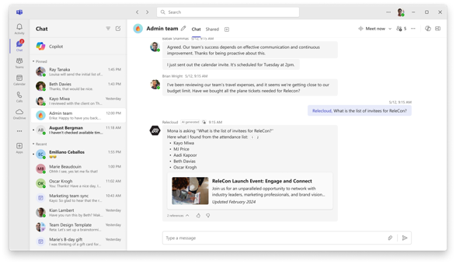
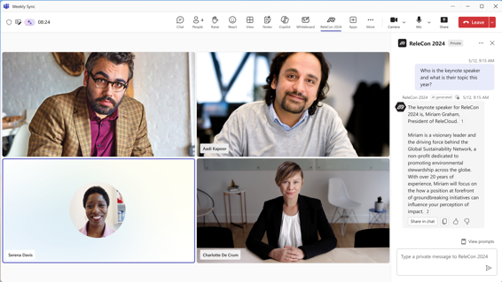
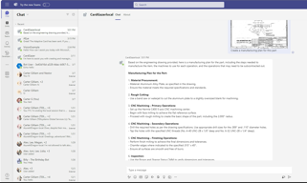
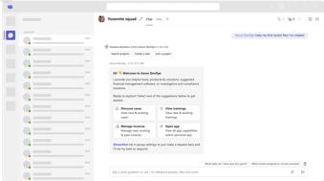
Agents as Teammates
Group Chats
Group Chats
Teams Collaborate with Agents to Achieve Goals
Specialized Insights for Faster Decisions
Proactive messaging and coordination on business-critical tasks drives alignment and execution.
Empower your team with the insights and confidence to move forward, reducing follow-ups.
Notes:
Whether you are in channels or group chats, or a meeting -- your agent can join your team and participate with specialized capabilities to drive alignment and execution.
For example: if you’re planning for an event or a sales call, your team can gather quick insights from your CRM, your chats, your SharePoint documents and your meetings from a Collaborative Agent to be better prepared
Ultimately, agents with group context become more effective teammates, enhancing collaboration and helping every team member perform at their best.

Slide 17
Agent architecture
Custom Engine Agents
User experience
Microsoft Teams
Microsoft 365 Copilot
Messenger
White label Web chat
Email
+10 other front-end channel
Knowledge
Instructions and Grounding
Agents
Orchestrator
Skills
Actions, triggers, workflows
Autonomy
Planning, exceptions, self-learning
Microsoft provided
Foundation models
Developer provided
Notes:
Carter
Here is general structure of a custom engine agent that you can fully customize as a developer
The Agent architecture consists of one or more foundational models, an orchestrator, knowledge, skills, autonomous capabilities and a user experience / UI
Foundational models are AI models that can perform a wide range of tasks, from language processing, visual comprehension, text generation, code writing and more.
Orchestrator oversees and synchronizes pre and post processing of the user prompt across foundation models, knowledge and actions.
Knowledge is the information agents can reason over to answer user prompts. Agents can expand their native semantic understanding beyond the source data used for their training to provide relevant, contextual responses.
Skills such as Actions are tasks agents can perform on your behalf, from real-time data lookups to executing changes and updates on behalf of the user.
Custom engine agents can be deployed across Microsoft Teams, M365 Copilot (coming soon), web, outlook and + other messaging channels.
The glue that holds everything together so you can accelerate your build are two SDKs: Microsoft 365 Agents SDK and the Teams AI Library

Slide 18

Agent architecture
Custom Engine Agents
User experience
Microsoft Teams
Knowledge
Instructions and Grounding
Agents
Orchestrator
Skills
Actions, triggers, workflows
Autonomy
Planning, exceptions, self-learning
Microsoft provided
Foundation models
Developer provided
Notes:
Carter
Here is general structure of a custom engine agent that you can fully customize as a developer
The Agent architecture consists of one or more foundational models, an orchestrator, knowledge, skills, autonomous capabilities and a user experience / UI
Foundational models are AI models that can perform a wide range of tasks, from language processing, visual comprehension, text generation, code writing and more.
Orchestrator oversees and synchronizes pre and post processing of the user prompt across foundation models, knowledge and actions.
Knowledge is the information agents can reason over to answer user prompts. Agents can expand their native semantic understanding beyond the source data used for their training to provide relevant, contextual responses.
Skills such as Actions are tasks agents can perform on your behalf, from real-time data lookups to executing changes and updates on behalf of the user.
Custom engine agents can be deployed across Microsoft Teams, M365 Copilot (coming soon), web, outlook and + other messaging channels.
The glue that holds everything together so you can accelerate your build are two SDKs: Microsoft 365 Agents SDK and the Teams AI Library

Slide 19
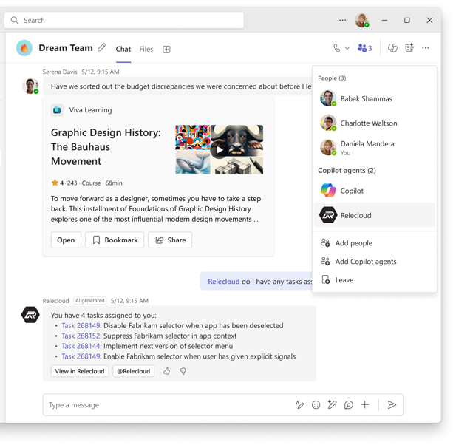

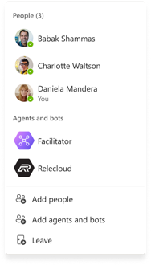
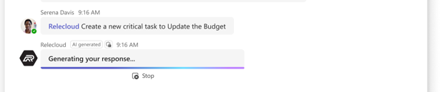
Teams Collaborative Agent UX
5
UX designed for teamwork
between agents and employees
6
1
Bot Framework & Teams AI Library
Roster Integration
Response Streaming
1
4
7
2
AI Labels
Source Citations
2
3
Feedback Buttons
Sensitivity Labels
Adaptive Cards
3
5
Inline Video
Ratings
6
Card Template Library
Fluent Icons
7
3
4
Notes:
We’ve invested in a UX built for collaboration between users and agents
Several new feature are coming to emphasize agents as teammates such as roster integration so users see which agents are in the chat along with their team
Other features made easy by the AI Library include:
AI Labels
Response streaming
Feedback buttons

Slide 20
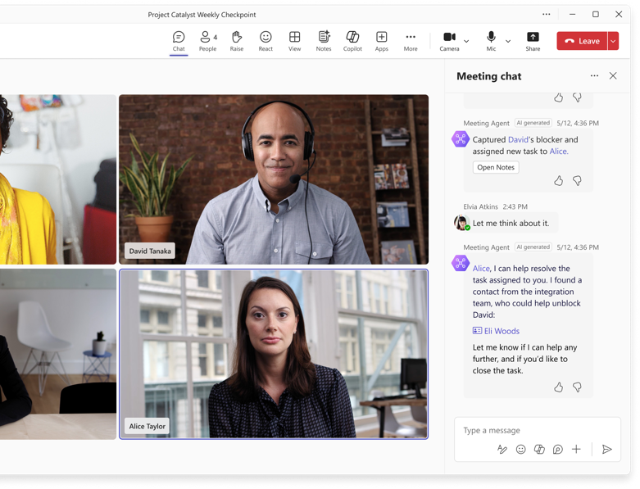
Teams Collaborative Agent UX
Strengthen collaboration and engagement with a familiar agent UX across chats, channels and meetings
Notes:
Beyond chats and channels, you agent works in a familiar UX in meeting chats too!

Slide 21
Agent architecture
Custom Engine Agents
User experience
Microsoft Teams
Microsoft 365 Copilot
Messenger
White label Web chat
Email
+10 other front-end channel
Knowledge
Instructions and Grounding
Agents
Orchestrator
Skills
Actions, triggers, workflows
Autonomy
Planning, exceptions, self-learning
Microsoft provided
Foundation models
Developer provided
Notes:
Carter
Here is general structure of a custom engine agent that you can fully customize as a developer
The Agent architecture consists of one or more foundational models, an orchestrator, knowledge, skills, autonomous capabilities and a user experience / UI
Foundational models are AI models that can perform a wide range of tasks, from language processing, visual comprehension, text generation, code writing and more.
Orchestrator oversees and synchronizes pre and post processing of the user prompt across foundation models, knowledge and actions.
Knowledge is the information agents can reason over to answer user prompts. Agents can expand their native semantic understanding beyond the source data used for their training to provide relevant, contextual responses.
Skills such as Actions are tasks agents can perform on your behalf, from real-time data lookups to executing changes and updates on behalf of the user.
Custom engine agents can be deployed across Microsoft Teams, M365 Copilot (coming soon), web, outlook and + other messaging channels.
The glue that holds everything together so you can accelerate your build are two SDKs: Microsoft 365 Agents SDK and the Teams AI Library

Slide 22
Agent architecture
Custom Engine Agents
User experience
Microsoft Teams
Microsoft 365 Copilot
Messenger
White label Web chat
Email
+10 other front-end channel
Knowledge
Microsoft Graph
Agents
Orchestrator
Skills
Actions, triggers, workflows
Autonomy
Planning, exceptions, self-learning
Microsoft provided
Foundation models
Developer provided
Notes:
Carter
Here is general structure of a custom engine agent that you can fully customize as a developer
The Agent architecture consists of one or more foundational models, an orchestrator, knowledge, skills, autonomous capabilities and a user experience / UI
Foundational models are AI models that can perform a wide range of tasks, from language processing, visual comprehension, text generation, code writing and more.
Orchestrator oversees and synchronizes pre and post processing of the user prompt across foundation models, knowledge and actions.
Knowledge is the information agents can reason over to answer user prompts. Agents can expand their native semantic understanding beyond the source data used for their training to provide relevant, contextual responses.
Skills such as Actions are tasks agents can perform on your behalf, from real-time data lookups to executing changes and updates on behalf of the user.
Custom engine agents can be deployed across Microsoft Teams, M365 Copilot (coming soon), web, outlook and + other messaging channels.
The glue that holds everything together so you can accelerate your build are two SDKs: Microsoft 365 Agents SDK and the Teams AI Library

Slide 23


Knowledge Sources for Collaborative Agents
Ground in Graph for Contextual Awareness
Web
Post meeting transcripts
Messages in chats, channels, and meetings
Files
Roster
Roles
Azure AI Search
Microsoft Graph
SharePoint
Notes:
Integrating knowledge—whether through Azure AI Search, SharePoint libraries, or Microsoft Graph—is one of the most valuable ways to enrich your agent.
Graph is especially valuable for agents in teams for gathering context from chats, channels and meetings.
It’s exciting to share that our “post meeting insights” feature – the AI Summary you see after meetings is coming to the graph APIs, and later this year the full real-time transcripts of meeting are also coming - in addition to what you already have with post-meeting transcript, roster, roles, and files.
Your agent has the context and knowledge of a teammate by using graph
<Now I am going to hand it over to Carter to walk you through additional options for knowledge sources, orchestration and more>

Slide 24
Agent architecture
Custom Engine Agents
User experience
Microsoft Teams
Microsoft 365 Copilot
Messenger
White label Web chat
Email
+10 other front-end channel
Knowledge
Memory
Agents
Orchestrator
Skills
Actions, triggers, workflows
Autonomy
Planning, exceptions, self-learning
Microsoft provided
Foundation models
Developer provided
Notes:
Carter
Here is general structure of a custom engine agent that you can fully customize as a developer
The Agent architecture consists of one or more foundational models, an orchestrator, knowledge, skills, autonomous capabilities and a user experience / UI
Foundational models are AI models that can perform a wide range of tasks, from language processing, visual comprehension, text generation, code writing and more.
Orchestrator oversees and synchronizes pre and post processing of the user prompt across foundation models, knowledge and actions.
Knowledge is the information agents can reason over to answer user prompts. Agents can expand their native semantic understanding beyond the source data used for their training to provide relevant, contextual responses.
Skills such as Actions are tasks agents can perform on your behalf, from real-time data lookups to executing changes and updates on behalf of the user.
Custom engine agents can be deployed across Microsoft Teams, M365 Copilot (coming soon), web, outlook and + other messaging channels.
The glue that holds everything together so you can accelerate your build are two SDKs: Microsoft 365 Agents SDK and the Teams AI Library

Slide 25
Importance of Memory in Agentic Systems
Practical considerations
Personal preferences = better recommendations
Continuity of interaction
Better decision making
Reduces redundancy
Reduce hallucinations
Emotional considerations
Builds trust
Reduces cognitive overhead
Enhances delight
Familiar interactions
Notes:
Agents retain conversational context and can reason over the current chat to a certain extant, but begin to lose important details over long running conversations or across different conversations
Memory helps fix this by giving the agent a way to store the context of previous interactions enabling the agent to make more informed decisions and provide more accurate responses.
When you tell your agent you’re a tax account in Washington state it can remember this context when giving advice relevant to that work vs a tax account in California.
Read Memory considerations and benefits

Slide 26
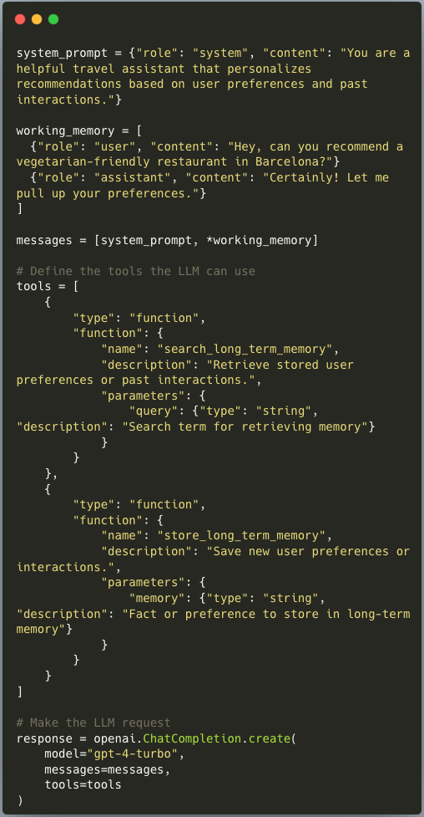
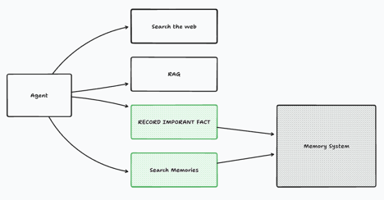
Memory with Teams AI Library
Automatic memory extraction
Working Memory for recent interactions
Long-term memory stores for persistent user information and future reference
Notes:
Until now, to build contextual understanding of user needs, you had to parse raw transcripts from any chat, channel, and meeting your agent operated and grabbed from graph, then synthesize it on your own. This led to inconsistent, complex, vulnerable, and error-prone implementations. Memory with the Teams AI Library fixes that. Agents can now utilize a sophisticated semantic memory system, encompassing three critical things: 1. Automatic memory extraction intelligently captures and stores relevant details without manual intervention.
2. Working memory retains recent interactions for immediate context.
3. Long-term memory stores persistent user information for future reference.
The agent is given access to the memory module as an explicit tool call to retrieve semantic memories if needed. The working memory on the other hand is fetched before the functional loop begins.
The memory extraction happens in the background whenever messages are received by the agent, or sent by the agent.

Slide 27
Agent architecture
Custom Engine Agents
User experience
Microsoft Teams
Microsoft 365 Copilot
Messenger
White label Web chat
Email
+10 other front-end channel
Knowledge
Instructions and Grounding
Agents
Orchestrator
Skills
Actions, triggers, workflows
Autonomy
Planning, exceptions, self-learning
Microsoft provided
Foundation models
Developer provided
Notes:
Carter
Here is general structure of a custom engine agent that you can fully customize as a developer
The Agent architecture consists of one or more foundational models, an orchestrator, knowledge, skills, autonomous capabilities and a user experience / UI
Foundational models are AI models that can perform a wide range of tasks, from language processing, visual comprehension, text generation, code writing and more.
Orchestrator oversees and synchronizes pre and post processing of the user prompt across foundation models, knowledge and actions.
Knowledge is the information agents can reason over to answer user prompts. Agents can expand their native semantic understanding beyond the source data used for their training to provide relevant, contextual responses.
Skills such as Actions are tasks agents can perform on your behalf, from real-time data lookups to executing changes and updates on behalf of the user.
Custom engine agents can be deployed across Microsoft Teams, M365 Copilot (coming soon), web, outlook and + other messaging channels.
The glue that holds everything together so you can accelerate your build are two SDKs: Microsoft 365 Agents SDK and the Teams AI Library

Slide 28
Agent architecture
Custom Engine Agents
User experience
Microsoft Teams
Microsoft 365 Copilot
Messenger
White label Web chat
Email
+10 other front-end channel
Knowledge
Instructions and Grounding
Agents
Skills
Actions, capabilities, triggers, workflows
Orchestrator
Autonomy
Planning, exceptions, self-learning
Microsoft provided
Foundation models
Developer provided
Notes:
Carter
Here is general structure of a custom engine agent that you can fully customize as a developer
The Agent architecture consists of one or more foundational models, an orchestrator, knowledge, skills, autonomous capabilities and a user experience / UI
Foundational models are AI models that can perform a wide range of tasks, from language processing, visual comprehension, text generation, code writing and more.
Orchestrator oversees and synchronizes pre and post processing of the user prompt across foundation models, knowledge and actions.
Knowledge is the information agents can reason over to answer user prompts. Agents can expand their native semantic understanding beyond the source data used for their training to provide relevant, contextual responses.
Skills such as Actions are tasks agents can perform on your behalf, from real-time data lookups to executing changes and updates on behalf of the user.
Custom engine agents can be deployed across Microsoft Teams, M365 Copilot (coming soon), web, outlook and + other messaging channels.
The glue that holds everything together so you can accelerate your build are two SDKs: Microsoft 365 Agents SDK and the Teams AI Library

Slide 29
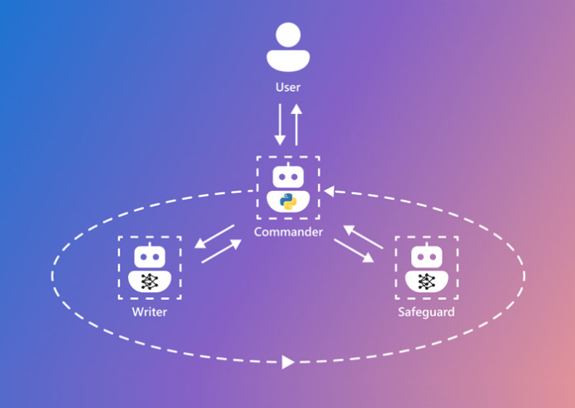
Custom Orchestration and Skills
Custom orchestration and skills enables your team to collaborate with a team of specialized agents
Notes:
Custom engine agents and the Teams AI Library allow for custom orchestration, which means you can choose auto-gen, lang chain, or use your own. This enable multi-agent interactions.

Slide 30
Live Demo with Team Data Analyst
Notes:
Let’s see collaborative custom agent in action.
For this we are going to use a sample from the Teams AI Library the Data Analyst, which is actually a team of agents that work together to dynamically generate adaptive card charts in teams utilizing your back data from SQL database per requests from a financial team
Chatting with your data is a top use case and enabling a team to chat with financial data with visual capabilities within teams showcases what’s possible beyond text to quickly gather insights and trends from dynamic charts without needing any database or power bi skills
Custom orchestration allows for multi-agents to work together and have each specialized roles for supporting a team’s needs.
🔍 Under the Hood: ⚡Data Analyst Agent (Orchestrator): The brains of the operation. ⚡SQL Expert Agent: Handles the database (so you don't have to!). ⚡AC Expert Agent: Adaptive Cards bringing data to life visually. ⚡Base Agent (LLM Powered): The natural language engine making it all intuitive.
In VSCode with data analyst
Once the pre-requisites are set up, all I have to do is press F5 to test the sample in teams
Here the data analyst is in a Teams channel, where we have an upcoming financial review
We can ask the analyst to give us the regional sales numbers for 2022 Q1 in natural language. No filtering, no opening power bi or creating a dashboard, the agent does it
Behind the scenes in the terminal we can see the agents coordinating with each other
In the app.ts file you can see the processingstate and progess update , which gives proactive updates to what the agent is doing from planning query, fetching data or generating the visualization keeping us in the loop on where it is at
Other items such as the feedbackloop are here

Slide 31
Agent architecture
Custom Engine Agents
User experience
Microsoft Teams
Microsoft 365 Copilot
Messenger
White label Web chat
Email
+10 other front-end channel
Knowledge
Instructions and Grounding
Agents
Orchestrator
Skills
Actions, triggers, workflows
Autonomy
Planning, exceptions, self-learning
Microsoft provided
Foundation models
Developer provided
Notes:
Carter
Here is general structure of a custom engine agent that you can fully customize as a developer
The Agent architecture consists of one or more foundational models, an orchestrator, knowledge, skills, autonomous capabilities and a user experience / UI
Foundational models are AI models that can perform a wide range of tasks, from language processing, visual comprehension, text generation, code writing and more.
Orchestrator oversees and synchronizes pre and post processing of the user prompt across foundation models, knowledge and actions.
Knowledge is the information agents can reason over to answer user prompts. Agents can expand their native semantic understanding beyond the source data used for their training to provide relevant, contextual responses.
Skills such as Actions are tasks agents can perform on your behalf, from real-time data lookups to executing changes and updates on behalf of the user.
Custom engine agents can be deployed across Microsoft Teams, M365 Copilot (coming soon), web, outlook and + other messaging channels.
The glue that holds everything together so you can accelerate your build are two SDKs: Microsoft 365 Agents SDK and the Teams AI Library

Slide 32
Agent architecture
Custom Engine Agents
User experience
Microsoft Teams
Microsoft 365 Copilot
Messenger
White label Web chat
Email
+10 other front-end channel
Knowledge
Instructions and Grounding
Agents
Orchestrator
Skills
Actions, triggers, workflows
Autonomy
Microsoft provided
Foundation models
Developer provided
Notes:
Carter
Here is general structure of a custom engine agent that you can fully customize as a developer
The Agent architecture consists of one or more foundational models, an orchestrator, knowledge, skills, autonomous capabilities and a user experience / UI
Foundational models are AI models that can perform a wide range of tasks, from language processing, visual comprehension, text generation, code writing and more.
Orchestrator oversees and synchronizes pre and post processing of the user prompt across foundation models, knowledge and actions.
Knowledge is the information agents can reason over to answer user prompts. Agents can expand their native semantic understanding beyond the source data used for their training to provide relevant, contextual responses.
Skills such as Actions are tasks agents can perform on your behalf, from real-time data lookups to executing changes and updates on behalf of the user.
Custom engine agents can be deployed across Microsoft Teams, M365 Copilot (coming soon), web, outlook and + other messaging channels.
The glue that holds everything together so you can accelerate your build are two SDKs: Microsoft 365 Agents SDK and the Teams AI Library

Slide 33
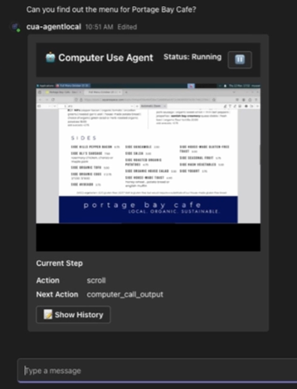
Autonomy Based on Trust
Transparency: Regular updates to understand the status of a task
Human in-the-loop: Users can adjust, approve, and extend tasks
Coordination: Business critical tasks rely on groups instead of individuals
Notes:
With greater autonomy comes the need for greater trust to provide confidence the agent is on track
Transparency: Agents regularly provide clear status updates, helping users track task progress and building confidence in agent reliability.
Human-in-the-loop: Users retain control and oversight, with the ability to adjust, approve, or extend tasks at critical decision points, ensuring outcomes meet expectations.
Coordination: Agents facilitate collaboration by effectively coordinating tasks with a team such as in a channel rather than relying solely on individual input, ensuring alignment and accountability for business-critical tasks
When something fails you have an it support channel with on call engineers being able to collaborate with the agent immediately

Slide 34
Agent architecture
Custom Engine Agents
User experience
Microsoft Teams
Microsoft 365 Copilot
Messenger
White label Web chat
Email
+10 other front-end channel
Knowledge
Instructions and Grounding
Agents
Orchestrator
Skills
Actions, triggers, workflows
Autonomy
Planning, exceptions, self-learning
Microsoft provided
Foundation models
Developer provided
Notes:
Carter
Here is general structure of a custom engine agent that you can fully customize as a developer
The Agent architecture consists of one or more foundational models, an orchestrator, knowledge, skills, autonomous capabilities and a user experience / UI
Foundational models are AI models that can perform a wide range of tasks, from language processing, visual comprehension, text generation, code writing and more.
Orchestrator oversees and synchronizes pre and post processing of the user prompt across foundation models, knowledge and actions.
Knowledge is the information agents can reason over to answer user prompts. Agents can expand their native semantic understanding beyond the source data used for their training to provide relevant, contextual responses.
Skills such as Actions are tasks agents can perform on your behalf, from real-time data lookups to executing changes and updates on behalf of the user.
Custom engine agents can be deployed across Microsoft Teams, M365 Copilot (coming soon), web, outlook and + other messaging channels.
The glue that holds everything together so you can accelerate your build are two SDKs: Microsoft 365 Agents SDK and the Teams AI Library

Slide 35
Agent architecture
Custom Engine Agents
User experience
Microsoft Teams
Microsoft 365 Copilot
Messenger
White label Web chat
Email
+10 other front-end channel
Knowledge
Instructions and Grounding
Agents
Orchestrator
Skills
Actions, triggers, workflows
Autonomy
Planning, exceptions, self-learning
Microsoft provided
Foundation models
GPT-4.5, Deepseek-V3, & More
Foundation models
GPT-4.5, Deepseek-V3, & More
Developer provided
Notes:
Carter
Here is general structure of a custom engine agent that you can fully customize as a developer
The Agent architecture consists of one or more foundational models, an orchestrator, knowledge, skills, autonomous capabilities and a user experience / UI
Foundational models are AI models that can perform a wide range of tasks, from language processing, visual comprehension, text generation, code writing and more.
Orchestrator oversees and synchronizes pre and post processing of the user prompt across foundation models, knowledge and actions.
Knowledge is the information agents can reason over to answer user prompts. Agents can expand their native semantic understanding beyond the source data used for their training to provide relevant, contextual responses.
Skills such as Actions are tasks agents can perform on your behalf, from real-time data lookups to executing changes and updates on behalf of the user.
Custom engine agents can be deployed across Microsoft Teams, M365 Copilot (coming soon), web, outlook and + other messaging channels.
The glue that holds everything together so you can accelerate your build are two SDKs: Microsoft 365 Agents SDK and the Teams AI Library

Slide 36

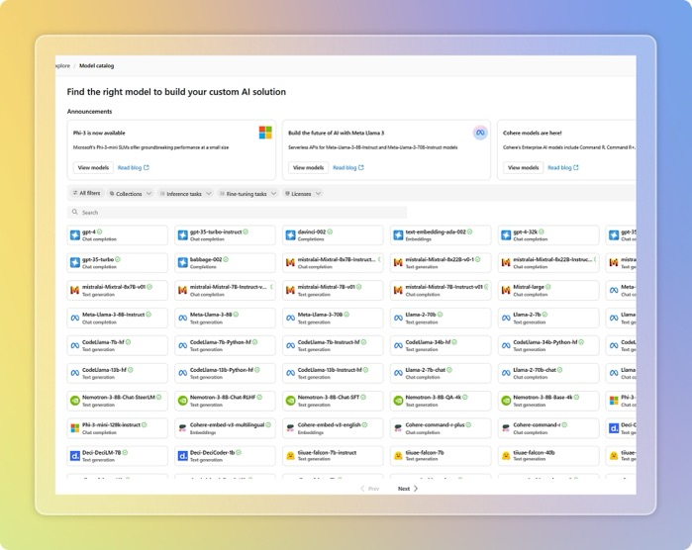





The Right Model for the Right Agent
Transparency: Regular updates to understand the status of a task
Human in-the-loop: Users can adjust, approve, and extend tasks
Coordination: Business critical tasks rely on groups instead of individuals
Notes:
CEA & Teams AI Model agnostic
Azure ai foundry
Openai
Huggingface

Slide 37
Developer Portal Streamline validation, packaging, publishing, and analysis of your agents

Slide 38
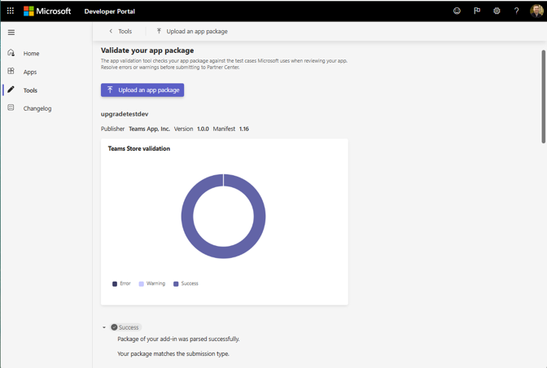
App Validation
Validate app packages with ease!
Checks against common policy violations
Resolve errors before submitting your app
More test coverage over time!
Notes:
App package validation is improving significantly by:
Automatically checking your app packages against common policy violations before submission.
Providing immediate, clear, and actionable feedback to help quickly identify and fix issues.
Continuously expanding validation test coverage to support evolving app standards and requirements.
Streamlining the overall submission process, accelerating deployment by ensuring compliance upfront.

Slide 39
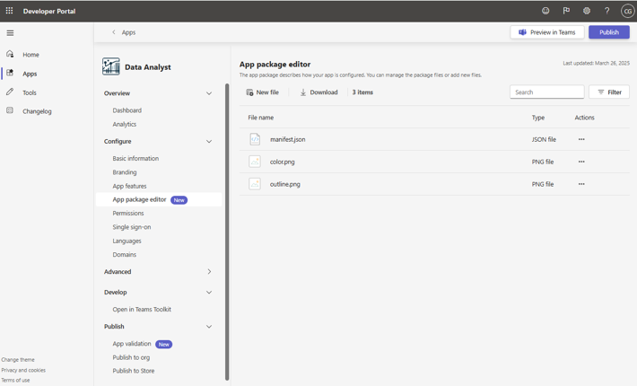
App Package Editor
Enhance your productivity!
Create, manage, and customize app packages
Edit your app components including:
manifest,
icons,
agent files,
and more
Notes:
Improvements to the App Package Editor streamlines how developers manage app configurations.
Quickly edit manifest files directly within the Developer Portal.
Easily add or remove package files, simplifying app updates and changes.
Offers seamless integration with the Microsoft 365 Agents Toolkit for consistent development workflows.
Enhances developer productivity, saving time by centralizing app package management.

Slide 40
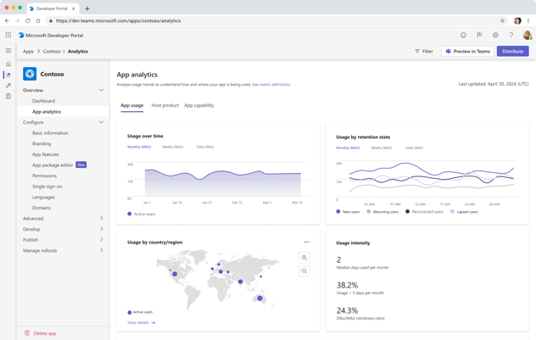
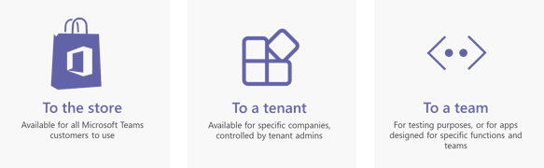
Publish Org-Wide or Worldwide with Developer Portal
Your SaaS app experience
320M+
500,000+
181
monthly active users of Microsoft Teams
organizations use Teams
markets with support for 53 languages
Microsoft Confidential
Notes:
When you’re ready to publish, Developer Portal simplifies distribution allowing you to publish your apps org-wide or worldwide to over 320 million Teams users

Slide 41
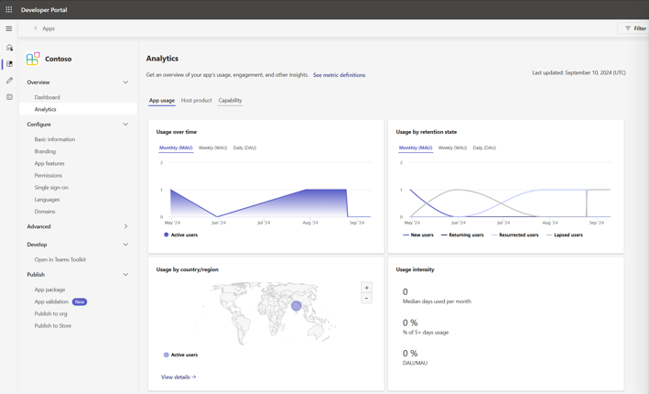
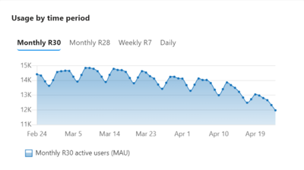
Analytics
Analyze App usage in Developer Portal
Trend of active users per month, week & day
Notes:
Analytics in Developer Portal gives you visibility into app and agent performance.
Easily monitor usage trends across different timeframes—daily, weekly, and monthly.
Track detailed insights such as platform usage and active users by host product (Teams, Outlook, Microsoft 365 Copilot).
Agent-specific analytics provide clarity on user engagement, helping you understand adoption and effectiveness.
Leverage these insights to continually optimize user experiences and enhance your app’s value.

Slide 42











See how customers are building for the Microsoft 365 ecosystem
Boost productivity with domain-specific LLMs and automate workflows
Offer legal assistance, analysis, and drafting for legal and professional services users
Align teams on shared goals for onboarding, support, and post-sale upsell
Enable sales teams to quickly find documents and summarize for more effective meetings
Enable employees to understand company goals, streamline their work, and grow
Search and summarize content to help win customers
Transform the way finance works and accelerate time to business impact
Provide timely marketing insights
Help protect your brand and quickly create compliant high-value business document
Copilot for Finance
Help sellers maximize their sales productivity
Use AI for effortless, more efficient work cross-platform
Automate end-to-end enterprise workflows within Copilot conversations
Copilot for Sales
Enhance service experiences and boost agent productivity
Give employees easier access to information they need and take actions across enterprise systems
Promote employee recognition by identifying and acknowledging key behaviors
Copilot for Service
Provide rapid, personalized support to handle employee issues with tailored conversations
Find and summarize murals and templates to save time and improve collaboration
Enable customers to manage IT tickets and resolve queries faster
Notes:
Build your agent and join the growing marketplace of agents from our partners and Microsoft– spanning across business functions and industry – so you can seamlessly bring the agents you need into Teams for collaboration of Microsoft 365 Copilot.

Slide 43
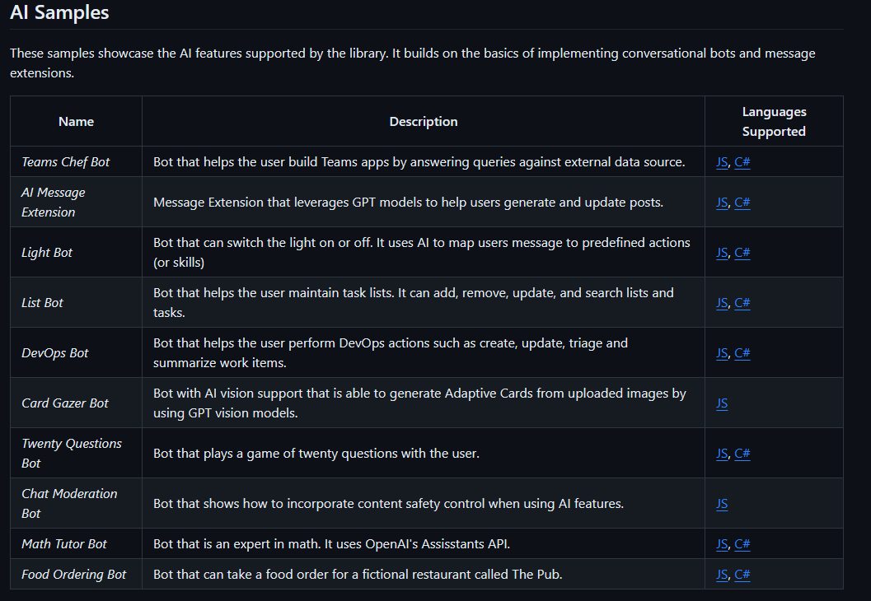
Start Building Today!
Try Samples on the Teams-AI GitHub Repository
Available Now
In JS, C#, & Python
aka.ms/CollabAgent
Notes:
If you want to get started, Try Teams Toolkit and the AI Library today knowing of all the exciting new features to come
Learn More:
aka.ms/CollabAgent
Try the samples from Presentation and let us know what you think:
https://github.com/microsoft/teams-agent-accelerator-samples

Slide 44
aka.ms/copilotdevcamp

Slide 45
Resources
Copilot Developer Camp: aka.ms/copilotdevcamp
Teams Toolkit for Visual Studio Code: aka.ms/teams-toolkit
Microsoft 365 Agents SDK docs: aka.ms/agentsdkdocs
Microsoft 365 Agents SDK repo: aka.ms/agentssdk
Teams AI Library documentation: aka.ms/collabagent
Teams AI Library repo: aka.ms/teams-ai-repo
Teams AI Accelerator repo: aka.ms/teams-templates-gallery

